Slide 1


5
Making
Decisions
C# Programming: From Problem Analysis to Program Design
4th Edition

Slide 2
Chapter Objectives
Learn about conditional expressions that return Boolean results and those that use the bool data type
Examine equality, relational, and logical operators used with conditional expressions
Write if selection type statements to include one-way, two-way, and nested forms
Learn about and write switch statements

Slide 3
Chapter Objectives (continued)
Learn how to use the ternary operator to write selection statements
Revisit operator precedence and explore the order of operations
Work through a programming example that illustrates the chapter’s concepts

Slide 4
Basic Programming Constructs
Simple sequence
Selection statement
if statement
switch
Iteration
Looping

Slide 5
Making Decisions
Central to both selection and iteration constructs
Enables deviation from sequential path in program
Involves conditional expression
“The test”
Produces Boolean result

Slide 6
Boolean Results and Bool Data Types
Boolean flags
Declare Boolean variable
bool identifier;
Initialize to true or false
Use to determine which statement(s) to perform
Example
bool moreData = true;
: // Other statement(s) that might change the
: // value of moreData to false.
if (moreData) // Execute statement(s) following the if
// when moreData is true

Slide 7
Conditional Expressions
Appear inside parentheses
Expression may be a simple Boolean identifier
if (moreData)
Two operands required when equality or relational symbols are used
Equality operator – two equal symbols (==)
Inequality operator – NOT equal (!=)
Relational operator – (<, >, <=, >=)

Slide 8
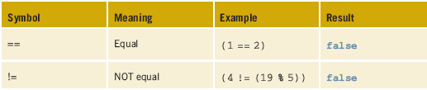
Equality, Relational and Logical Tests
Table 5-1 Equality operators
Returns true
operand1 = 25
operand1 = = Math.Pow(5, 2);

Slide 9
Equality Operators
Conventional to place the variable in the first operand location; value or expression in the second location
Be careful comparing floating-point variables
Unpredictable results
= = and != are overloaded
Strings compared different from integral values

Slide 10
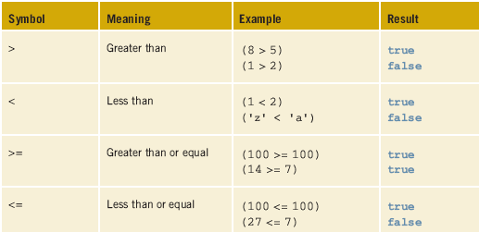
Equality, Relational and Logical Tests
Table 5-2 Relational operators

Slide 11
Relational Test
Unicode character set used for comparing characters declared as char
Cannot compare string operands using relational symbols
string class has number of useful methods for dealing with strings (Chapter 7)
Compare( ) method
Strings can be compared using = = and !=

Slide 12
Relational Test
Avoid compounds if you can
examScore >= 90
examScore > 89
Sometimes can add or subtract one from value
Develop good style by surrounding operators with a space

Slide 13
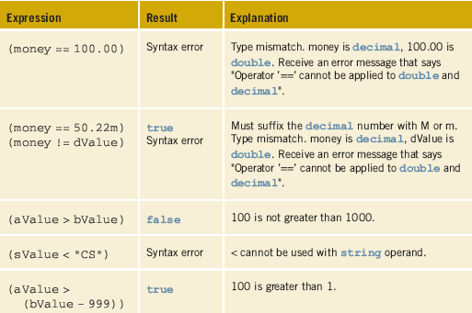
Relational Tests
int aValue = 100,
bValue = 1000;
decimal money =
50.22m;
double dValue =
50.22;
string sValue =
"CS158";
Table 5-3 Results of sample
conditional expressions

Slide 14
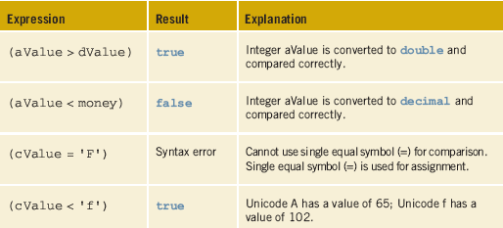
Relational Tests
int aValue = 100;
decimal money =
50.22m;
double dValue =
50.22;
char cValue = 'A';
Table 5-3 Results of sample
conditional expressions

Slide 15
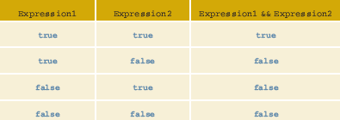
Logical Operators
Table 5-4 is sometimes referred to as a truth table
(examScore > 69 < 91) //Invalid
(69 < examScore < 91) //Invalid
((examScore > 69) && (examScore < 91)) //Correct way

Slide 16
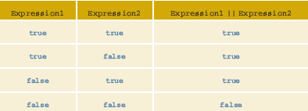
Logical Operators
Table 5-5 Conditional logical OR ( || )
(letterGrade == 'A' || 'B') //Invalid
((letterGrade == 'A') || (letterGrade == 'B')) //Correct way

Slide 17

Logical Operators
Table 5-6 Logical NOT ( ! )
NOT operator (!) returns the logical complement, or negation, of its operand
Easier to debug a program that includes only positive expressions

Slide 18
Short-Circuit Evaluation
Short-circuiting logical operators
&& and ||
OR (||) expressions – if the first evaluates as true, no need to evaluate the second operand
AND (&&) expressions – if the first evaluates as false, no need to evaluate second operand
C# also includes the & and | operators
Logical, do not perform short-circuit evaluation

Slide 19
Short-Circuit Evaluation
int examScore = 75;
int homeWkGrade = 100;
double amountOwed = 0;
char status = 'I';
((examScore > 90) && (homeWkGrade > 80))
((amountOwed == 0) || (status == 'A'))
No need to evaluate the second expression
Again, no need to evaluate the second expression

Slide 20
Boolean Data Types
bool type holds the value of true or false
When a bool variable is used in a conditional expression, you do not have to add symbols to compare the variable against a value
Boolean flags used as flags to signal when a condition exists or when a condition changes
if (moreData)

Slide 21
if...else Selection Statements
Classified as one-way, two-way, or nested
Alternate paths based on result of conditional expression
Expression must be enclosed in parentheses
Produce a Boolean result
One-way
When expression evaluates to false, statement following expression is skipped or bypassed
No special statement(s) is included for the false result

Slide 22
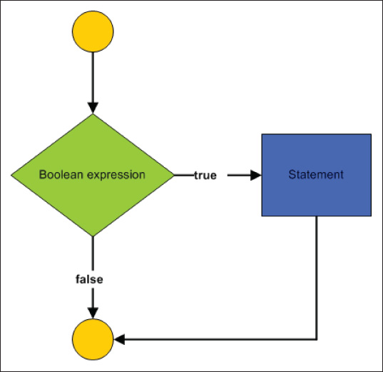
One-Way Selection Statement
if (expression)
{
statement;
}
No semicolon placed at end of expression
Null statement
Curly braces required with multiple statements
Figure 5-1
One-way if statement

Slide 23
One-Way if Statement
if (examScore > 89)
{
grade = 'A';
Console.WriteLine("Congratulations - Great job!");
}
Console.WriteLine("I am displayed, whether the expression "
+ "evaluates true or false");

Slide 24
One-Way if Selection Statement Example
/* BonusCalculator.cs Author: Doyle */
using System;
namespace BonusApp
{
class BonusCalculator
{
static void Main( )
{
string inValue;
decimal salesForYear, bonusAmount = 0M;
Console.WriteLine("Do you get a bonus this year?");
Console.WriteLine( );
Console.WriteLine("To determine if you are due one, ");

Slide 25
Console.Write("enter your gross sales figure: ");
inValue = Console.ReadLine();
salesForYear = Convert.ToDecimal(inValue);
if (salesForYear > 500000.00M)
{
Console.WriteLine( );
Console.WriteLine("YES...you get a bonus!");
bonusAmount = 1000.00M;
}
Console.WriteLine("Bonus for the year: {0:C}",
bonusAmount);
Console.ReadLine( );
} // end of Main( ) method
} // end of class BonusCalculator
} // end of BonusApp namespace

Slide 26
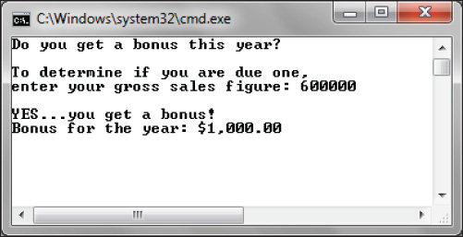
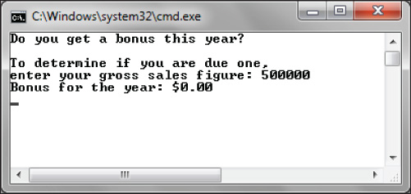

Output from BonusCalculator
Figure 5-2 BonusApp
with salesForYear equal
to 600,000.00
Figure 5-3 BonusApp
with salesForYear
equal to 500,000.00

Slide 27

One-Way if Selection Statement
Warning…did you accidently add an extra semi-colon?
Figure 5-4 Intellisense pop-up message
One-way if statement does not provide an set of steps for situations where the expression evaluates to false

Slide 28
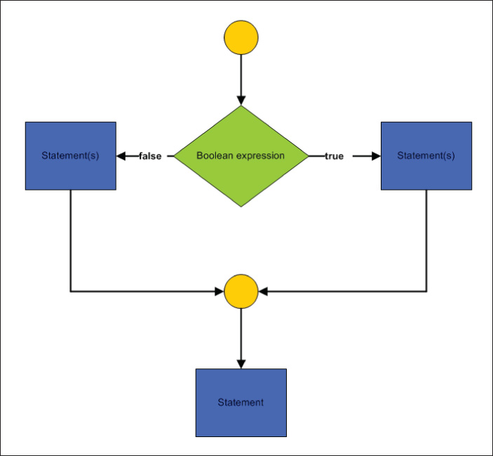
Two-Way Selection Statement
Either the true statement(s) executed or the false statement(s), but not both
No need to repeat expression test in else portion
Figure 5-5 Two-way if statement

Slide 29
Two-Way Selection Statement (continued)
if (expression)
{
statement;
}
else
{
statement;
}
Readability is important… Notice the indentation

Slide 30
Two-Way if…else Selection Statement Example
if (hoursWorked > 40)
{
payAmount = (hoursWorked – 40) * payRate * 1.5 + payRate * 40;
Console.WriteLine("You worked {0} hours overtime.",
hoursWorked – 40);
}
else
payAmount = hoursWorked * payRate;
Console.WriteLine("Displayed, whether the expression evaluates" +
" true or false");

Slide 31
TryParse( ) Method
Parse( ) method and methods in Convert class convert string values sent as arguments to their equivalent numeric value
If the string value being converted is invalid, program crashes
Exception is thrown
Could test the value prior to doing conversion with an if statement
Another option is to use the TryParse( ) method

Slide 32
TryParse( ) Method
public static bool TryParse
(string someStringValue, out int result)
if (int.TryParse(inValue, out v1) = = false)
Console.WriteLine("Did not input a valid integer - " +
"0 stored in v1");
Result stored here, when conversion occurs
String value returned from Console.ReadLine( )
Test…if problem, prints message, does not try to convert

Slide 33
TryParse( ) Method
Each of the built in data types have a TryParse( ) method
char.TryParse( ), int.TryParse( ), decimal.TryParse( ), etc
If there is a problem with the data, 0 is stored in the out argument and TryParse( ) returns false.
Show LargestValue example

Slide 34
Two-way if…else
Try to avoid repeating code
if (value1 > value2)
{
Console.WriteLine("The largest value entered was “ + value1);
Console.WriteLine("Its square root is {0:f2}", Math.Sqrt(value1));
}
else
{
Console.WriteLine("The largest value entered was “ + value2);
Console.WriteLine("Its square root is {0:f2}", Math.Sqrt(value2));
}

Slide 35
Alternative Solution
int largest;
if (value1 > value2)
{
largest = value1;
}
else
{
largest = value2;
}
Console.WriteLine("The largest value entered was " + largest);
Console.WriteLine("Its square root is {0:f2}", Math.Sqrt(largest));
What happens when value1 has the same value as value2?

Slide 36
Nested if…else Statement
Acceptable to write an if within an if
When block is completed, all remaining conditional expressions are skipped or bypassed
Syntax for nested if…else follows that of two-way
Difference: With a nested if…else, the statement may be another if statement
No restrictions on the depth of nesting
Limitation comes in the form of whether you and others can read and follow your code

Slide 37
Nested if…else Statement (continued)
bool hourlyEmployee;
double hours, bonus;
int yearsEmployed;
if (hourlyEmployee)
if (hours > 40)
bonus = 500;
else
bonus = 100;
else
if (yearsEmployed > 10)
bonus = 300;
else bonus = 200;
Bonus is assigned 100 when
hourlyEmployee = = true
AND
hours is less than OR equal to 40

Slide 38
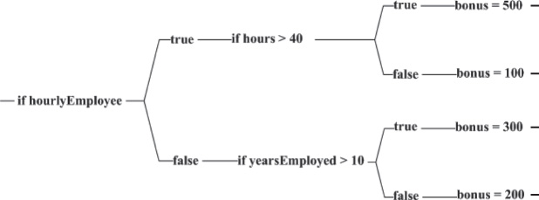
Nested if…else Statement (continued)
Figure 5-7 Bonus decision tree

Slide 39
Matching up Else and If Clauses
if (aValue > 10) // Line 1
if (bValue == 0) // Line 2
amount = 5; // Line 3
else // Line 4
if (cValue > 100) // Line 5
if (dValue > 100) // Line 6
amount = 10; //Line 7
else // Line 8
amount = 15; // Line 9
else // Line 10
amount = 20; // Line 11
else // Line 12
if (eValue == 0) // Line 13
amount = 25; // Line 14
else goes with the closest previous if that does not have its own else

Slide 40
Matching up Else and If Clauses
You can use braces to attach an else to an outer if
if (average > 59)
{
if (average < 71)
grade = 'D';
}
else
grade = 'F';

Slide 41
Nested if…else Statement
if (average > 89)
grade = 'A';
else
if (average > 79)
grade = 'B';
else
if (average > 69)
grade = 'C';
// More statements follow
Not necessary for second expression to be a compound expression using &&.
You do not have to write
if (average > 79 &&
average <= 89)

Slide 42
Nested if…else Statement
Could be written with a series of if. . . else statements
This prevents indentation problems
if (average > 89)
grade = 'A';
else if (average > 79)
grade = 'B';
else if (average > 69)
grade = 'C';
else if (average > 59)
grade = 'D';
else
grade = 'F';

Slide 43
Nested if…else Statement
if (weekDay == 1)
Console.WriteLine("Monday");
else if (weekDay == 2)
Console.WriteLine("Tuesday");
else if (weekDay == 3)
Console.WriteLine("Wednesday");
else if (weekDay == 4)
Console.WriteLine("Thursday");
else if (weekDay == 5)
Console.WriteLine("Friday");
else
Console.WriteLine("Not Monday through Friday");
When you have a single variable being tested for equality against four or more values, a switch statement can be used

Slide 44
Switch Statement
switch (weekDay)
{
case 1: Console.WriteLine("Monday");
break;
case 2: Console.WriteLine("Tuesday");
break;
case 3: Console.WriteLine("Wednesday");
break;
: // Lines missing;
default: Console.WriteLine("Not Monday through Friday");
break;
}

Slide 45
Switch Selection Statements
Multiple selection structure
Also called case statement
Works for tests of equality only
Single variable or expression tested
Must evaluate to an integral or string value
Requires the break for any case
No fall-through available

Slide 46
Switch Statements General Form
switch (expression)
{
case value1: statement(s);
break;
. . .
case valueN: statement(s);
break;
[default: statement(s);
break;]
}
Selector
Value must be of the same type as selector
Optional

Slide 47
Switch Statement Example
/* StatePicker.cs Author: Doyle */
using System;
namespace StatePicker
{
class StatePicker
{
static void Main( )
{
string stateAbbrev;
Console.WriteLine("Enter the state abbreviation. ");
Console.WriteLine("Its full name will be displayed");
Console.WriteLine( );
stateAbbrev = Console.ReadLine( );

Slide 48
switch(stateAbbrev)
{
case "AL": Console.WriteLine("Alabama");
break;
case "FL": Console.WriteLine("Florida");
break;
: // More states included
case "TX": Console.WriteLine("Texas");
break;
default: Console.WriteLine("No match");
break;
} // End switch
} // End Main( )
} // End class
} // End namespace

Slide 49
Switch Statements
Associate same executable with more than one case
Example (creates a logical OR)
case "AL":
case "aL":
case "Al":
case "al": Console.WriteLine("Alabama");
break;
Cannot test for a range of values

Slide 50
Switch Statement
break statement is required as soon as a case includes an executable statement
No fall through
switch (examScore / 10)
{
case 1:
case 2:
case 3:
case 4:
case 5: Console.WriteLine("Failing Grade");
break;

Slide 51
Switch Statements (continued)
Case value must be a constant literal
Cannot be a variable
int score,
high = 90;
switch (score)
{
case high : // Syntax error. Case value must be a constant
// Can write "case 90:" but not "case high:"
Value must be a compatible type
char value enclosed in single quote
string value enclosed in double quotes

Slide 52
Ternary Operator ? :
Also called conditional operator
General form
expression1 ? expression2 : expression3;
When expression1 evaluates to true, expression2 is executed
When expression1 evaluates to false, expression3 is executed
Example
grade = examScore > 89 ? 'A' : 'C';

Slide 53
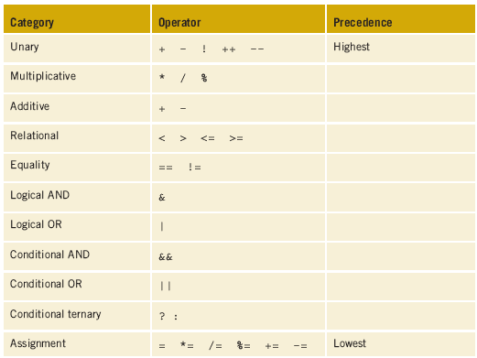
Order of Operations
Table 5-7
Operator
precedence

Slide 54
Order of Operations (continued)
Precedence of the operators
Associativity
Left-associative
All binary operators except assignment operators
Right-associative
Assignment operators and the conditional operator ?
Operations are performed from right to left
Order changed through use of parentheses

Slide 55
Order of Operations (continued)
int value1 = 10, value2 = 20, value3 = 30, value4 = 40, value5 = 50;
if (value1 > value2 || value3 == 10 && value4 + 5 < value5)
1. (value4 + 5) → (40 + 5) → 45
2. (value1 > value2) → (10 > 20) → false
3. ((value4 + 5) < value5) → (45 < 50) → true
4. (value3 == 10) → (30 == 10) → false
5. ((value3 == 10) && ((value4 + 5) < value5)) → false && true
→ false
6. ((value1 > value2) || ((value3 == 10) && ((value4 + 5) < value5)))
→ false || false → false

Slide 56
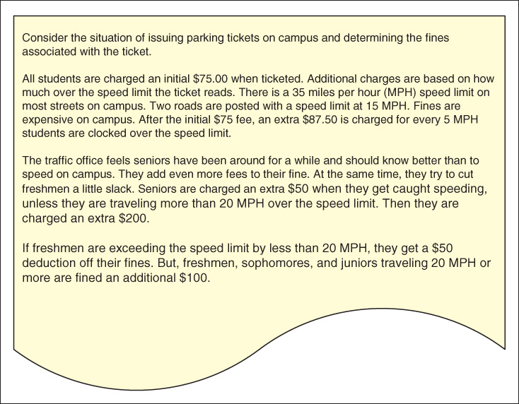
SpeedingTicket Application
Figure 5-8 Problem specification for SpeedingTicket example

Slide 57
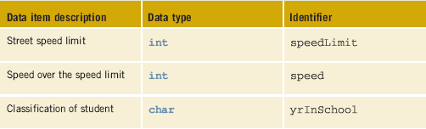
Data for the SpeedingTicket Example
Table 5-8 Instance variables for the Ticket class

Slide 58
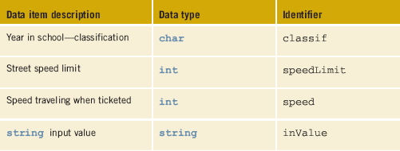
Data for the SpeedingTicket Example
Table 5-9 Local variables for the SpeedingTicket application class

Slide 59
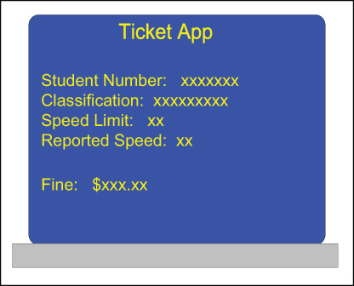
SpeedingTicket Example
Figure 5-9 Prototype for the SpeedingTicket example

Slide 60
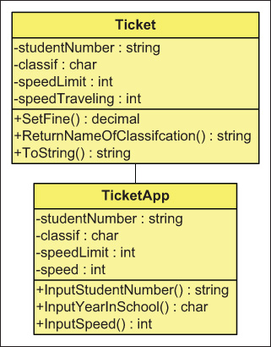
SpeedingTicket Example (continued)
Figure 5-10 Class diagrams for the SpeedingTicket example

Slide 61
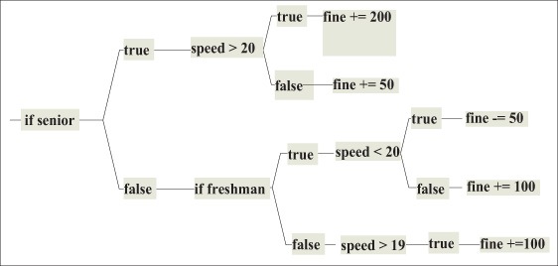
SpeedingTicket Example (continued)
Figure 5-11 Decision tree for SpeedingTicket example

Slide 62
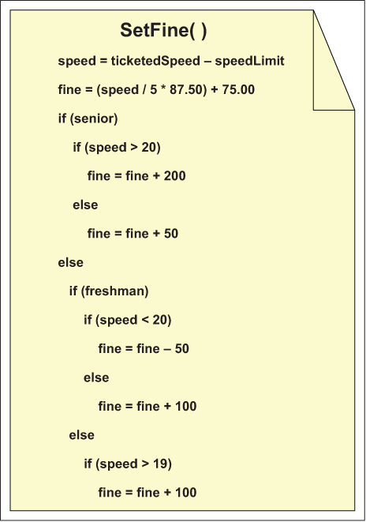
SpeedingTicket Example (continued)
Figure 5-12 Pseudocode for the SetFine() method

Slide 63
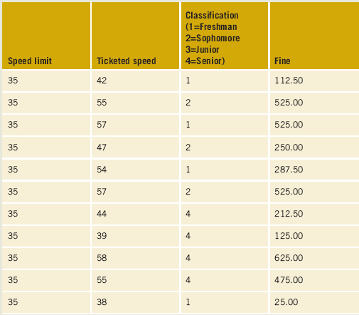
SpeedingTicket Example (continued)
Table 5-10 Desk check of Speeding algorithm

Slide 64
/* Ticket.cs Author: Doyle
* Describes the characteristics of a
* speeding ticket to include the speed
* limit, ticketed speed, and fine amount.
* The Ticket class is used to set the
* amount for the fine.
* **************************************/
using System;
namespace TicketSpace
{
public class Ticket
{
private const decimal COST_PER_5_OVER = 87.50M;
private int speedLimit;
private int speed;
private decimal fine;
public Ticket( ) { }
Ticket class

Slide 65
public Ticket(int speedLmt, int reportedSpeed)
{
speedLimit = speedLmt;
speed = reportedSpeed - speedLimit;
}
public decimal Fine
{
get
{
return fine;
}
}
public void SetFine(char classif)
{
fine = (speed / 5 * COST_PER_5_OVER) + 75.00M;

Slide 66
if (classif == '4')
if (speed > 20)
fine += 200;
else
fine += 50;
else
if (classif == '1')
if (speed < 21)
fine -= 50;
else
fine += 100;
else
if (speed > 20)
fine += 100;
} // End SetFine( ) method
} // End Ticket class
} // End TicketSpace

Slide 67
/* TicketApp.cs Author: Doyle
* Instantiates a Ticket object
* from the inputted values of
* speed and speed limit. Uses
* the year in school classification
* to set the fine amount.
* * *********************************/
using System;
namespace TicketSpace
{
public class TicketApp
{
static void Main( )
{
int speedLimit,
speed;
char classif;
TicketApp class

Slide 68
speedLimit = InputSpeed("Speed Limit", out speedLimit);
speed = InputSpeed("Ticketed Speed", out speed);
classif = InputYearInSchool( );
Ticket myTicket = new Ticket(speedLimit, speed);
myTicket.SetFine(classif);
Console.WriteLine("Fine: {0:C}", myTicket.Fine);
}
public static int InputSpeed(string whichSpeed)
{
string inValue;
int speed;
Console.Write("Enter the {0}: ", whichSpeed);
inValue = Console.ReadLine();
if (int.TryParse(inValue, out speed) == false)
Console.WriteLine("Invalid entry entered "+
"for {0} - 0 was recorded", whichSpeed);
return speed;
}

Slide 69
public static char InputYearInSchool ( )
{
string inValue;
char yrInSchool;
Console.WriteLine("Enter your classification:" );
Console.WriteLine("\tFreshmen (enter 1)");
Console.WriteLine("\tSophomore (enter 2)");
Console.WriteLine("\tJunior (enter 3)");
Console.Write("\tSenior (enter 4)");
Console.WriteLine();
inValue = Console.ReadLine();
yrInSchool = Convert.ToChar(inValue);
return yrInSchool;
} // End InputYearInSchool( ) method
} // End TicketApp class
} // End TicketSpace namespace

Slide 70
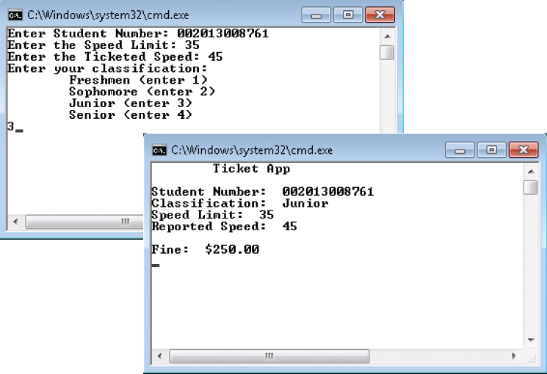
SpeedingTicket Example (continued)
Figure 5-13 Output from the SpeedingTicket example

Slide 71
Coding Standards
Guidelines for Placement of Curly Braces
Guidelines for Placement of else with Nested if Statements
Guidelines for Use of White Space with a Switch Statement
Spacing Conventions
Advanced Selection Statement Suggestions

Slide 72
Resources
C# Coding Style Guide - TechNotes, HowTo Series –
http://www.icsharpcode.net/TechNotes/SharpDevelopCodingStyle03.pdf
Microsoft C# if statement Tutorial –
http://csharp.net-tutorials.com/basics/if-statement/
if-else (C# Reference) –
http://msdn.microsoft.com/en-us/library/5011f09h.aspx
switch (C# Reference) –
http://msdn.microsoft.com/en-us/library/06tc147t

Slide 73
Chapter Summary
Three basic programming constructs
Simple Sequence, Selection, Iteration
Boolean variables
Boolean flags
Conditional expressions
Boolean results
True/false
Equality, relational, and logical operators

Slide 74
Chapter Summary (continued)
If selection statements
One-way
Two-way (if…else)
Nested if
Switch statement
Ternary operator
Operator precedence
Order of operation

